Slide 1
Stream Gaging Program
DNR Division of Ecological & Water Resources (EWR)

Slide 2
Water Quantity Monitoring Programs
Lake Water Levels
Precipitation and Climate
Groundwater Levels
Stream Flow and Water Levels

Slide 3
Citizen Scientists - Lake Level Monitoring

Slide 4
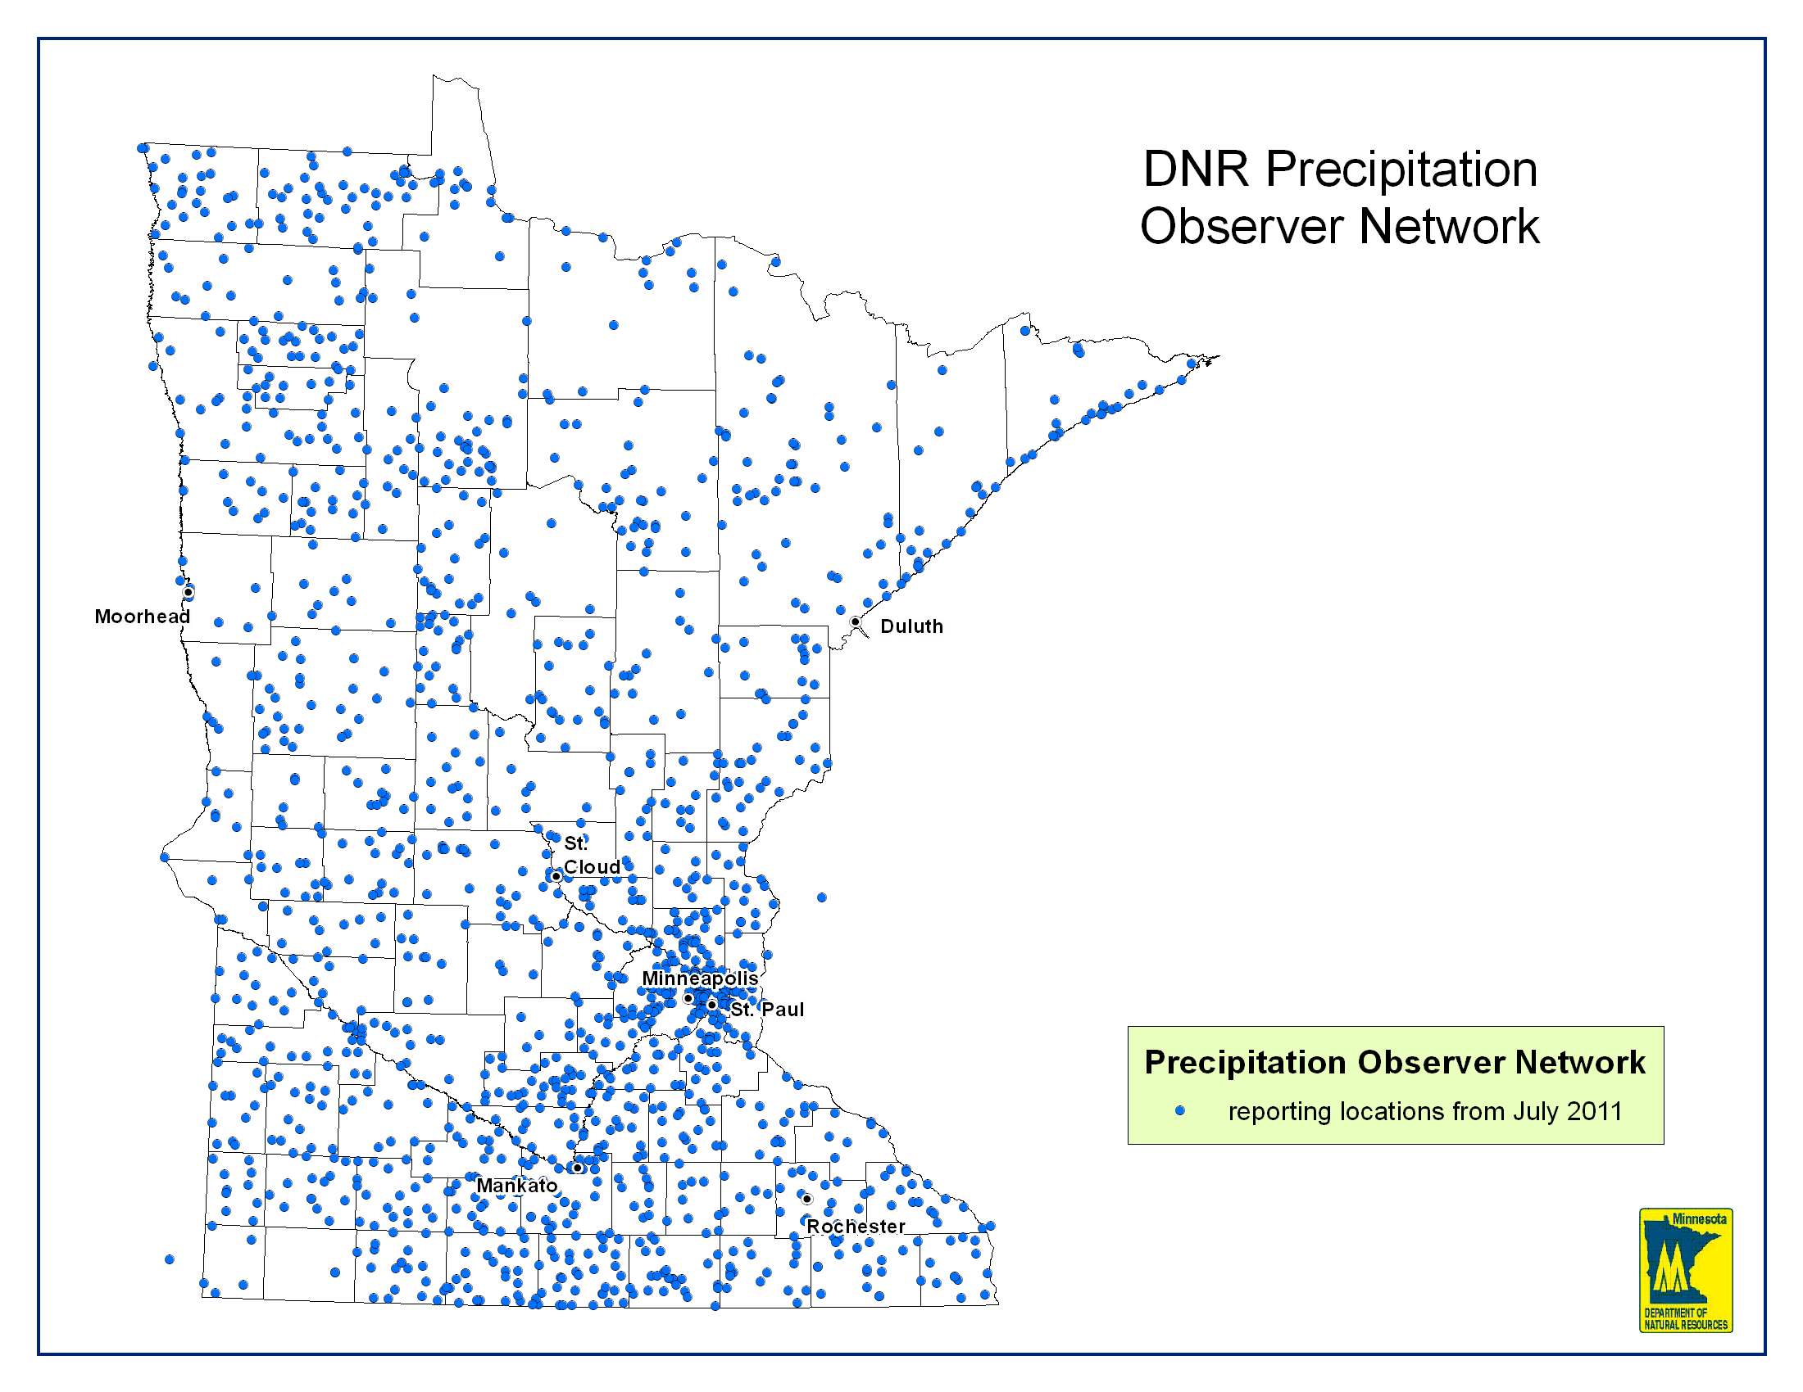
Citizen Scientists - Precipitation Monitoring Network

Slide 5
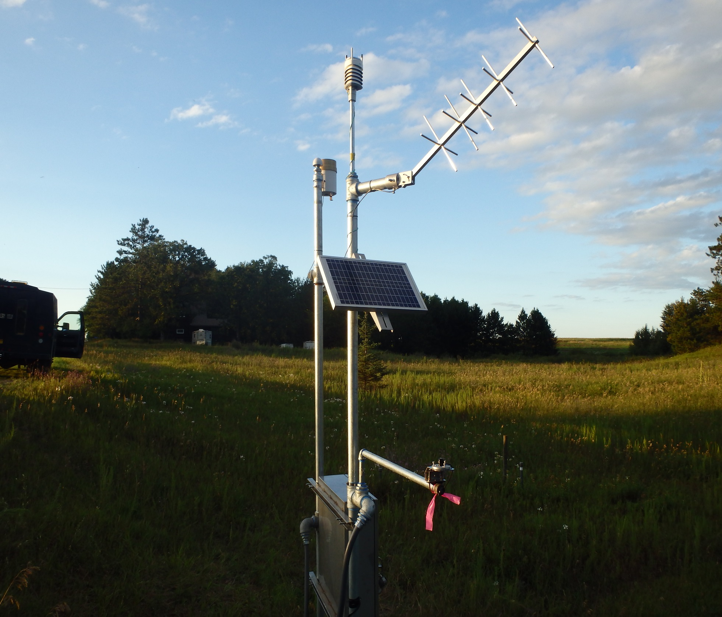
Real time weather stations
Agriculture - Irrigation
Long term changes in climate

Slide 6
Accelerated Ground Water Monitoring

Slide 7
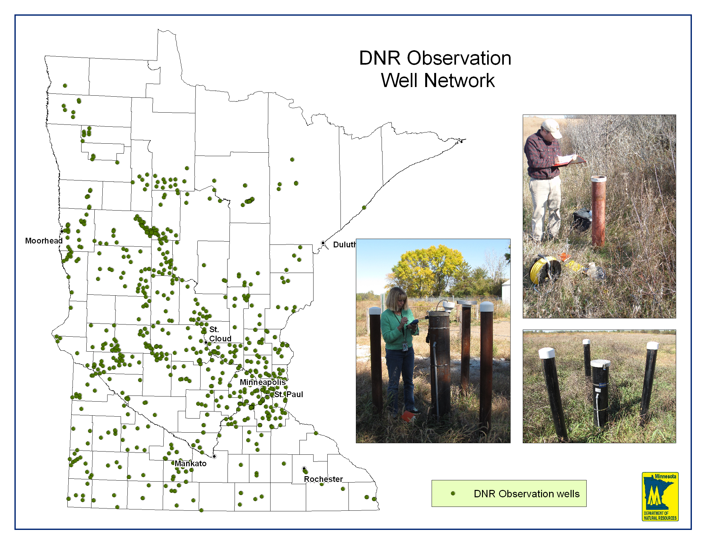
Accelerated Ground Water Monitoring
Notes:
Recently acquired shallow drill rig for surficial well installation for state agencies - DNR PCA MDA
Sense of urgency –limited resources increased demand.

Slide 9
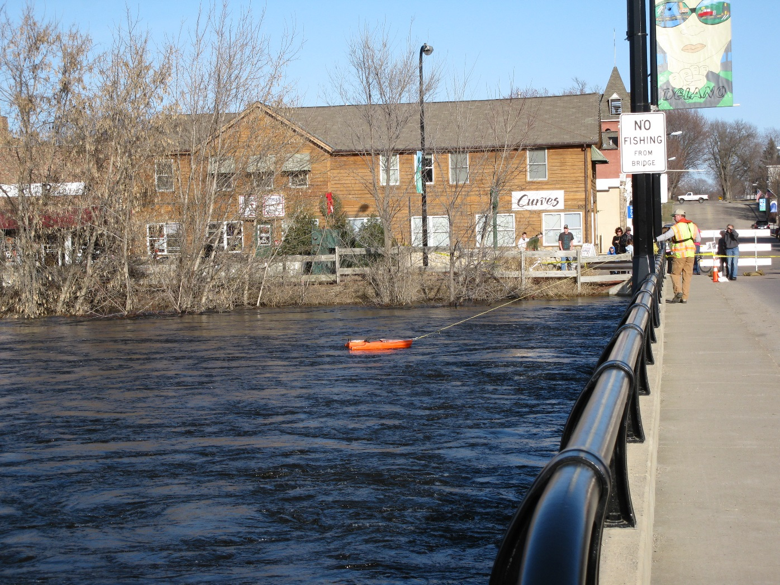
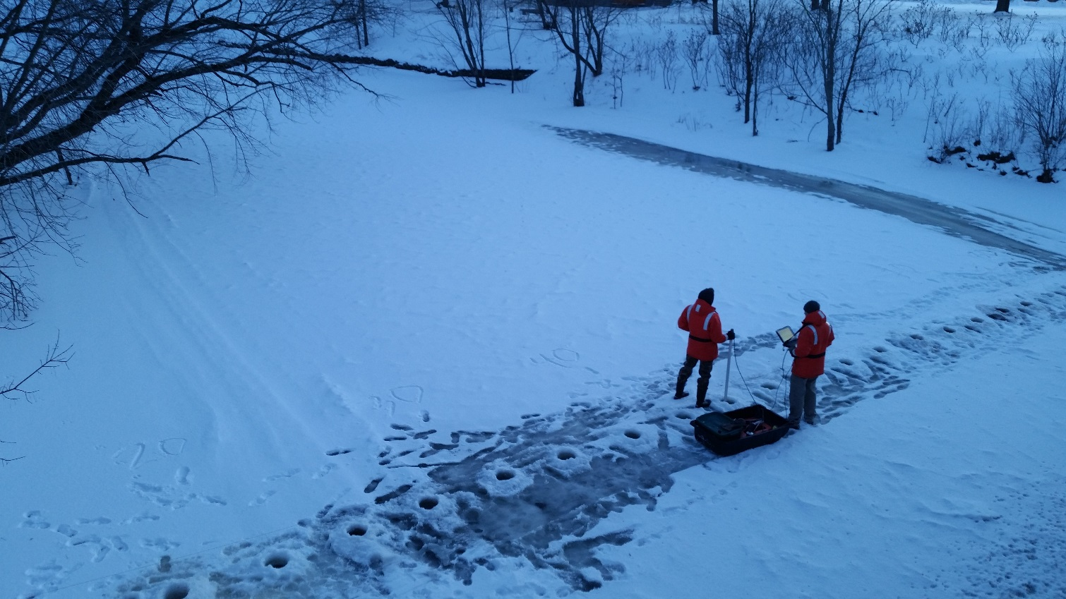
Standardization of Equipment and Data Collection

Slide 10
DNR Cooperative Stream Gaging Network
+280 Stream gages
180 with real time data
Uses
Water quality
Flood warning
Water quantity
Water recreation
Sediment loading and stream restoration
Multiple Use

Slide 11
Cooperators and Partners: Sharing of data and resources
Federal Agencies
USGS, National Weather Service, USFWS,USACE
State Agencies
PCA, MDA
Local Government
Watershed Districts, Cities, Counties
Private Industry and Organizations

Slide 12
Summer Flooding 2018
Assist National Weather Service for flood predictions and warnings
Critical information for federal aid requests
Planning and infrastructure design and repair

Slide 13
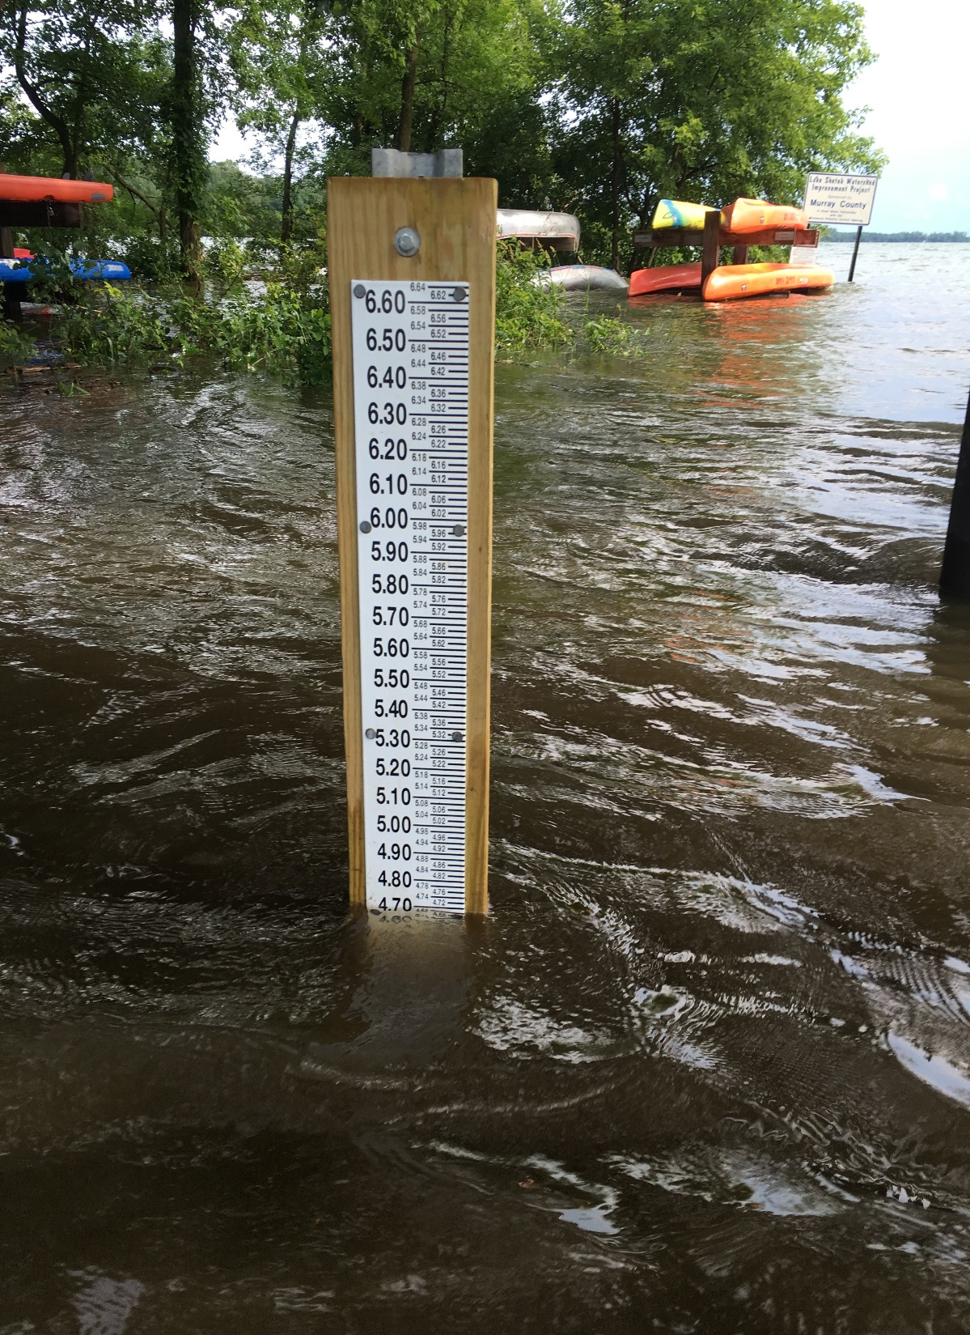
Lake Shetek, Murray County: July 2018

Slide 14
Cooperative Stream Gaging

Slide 15
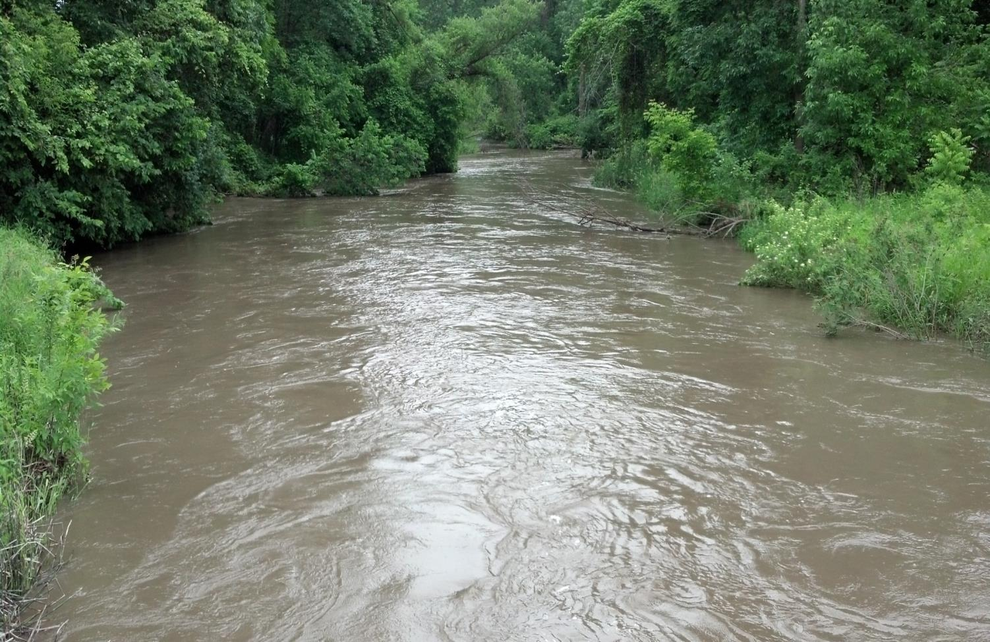
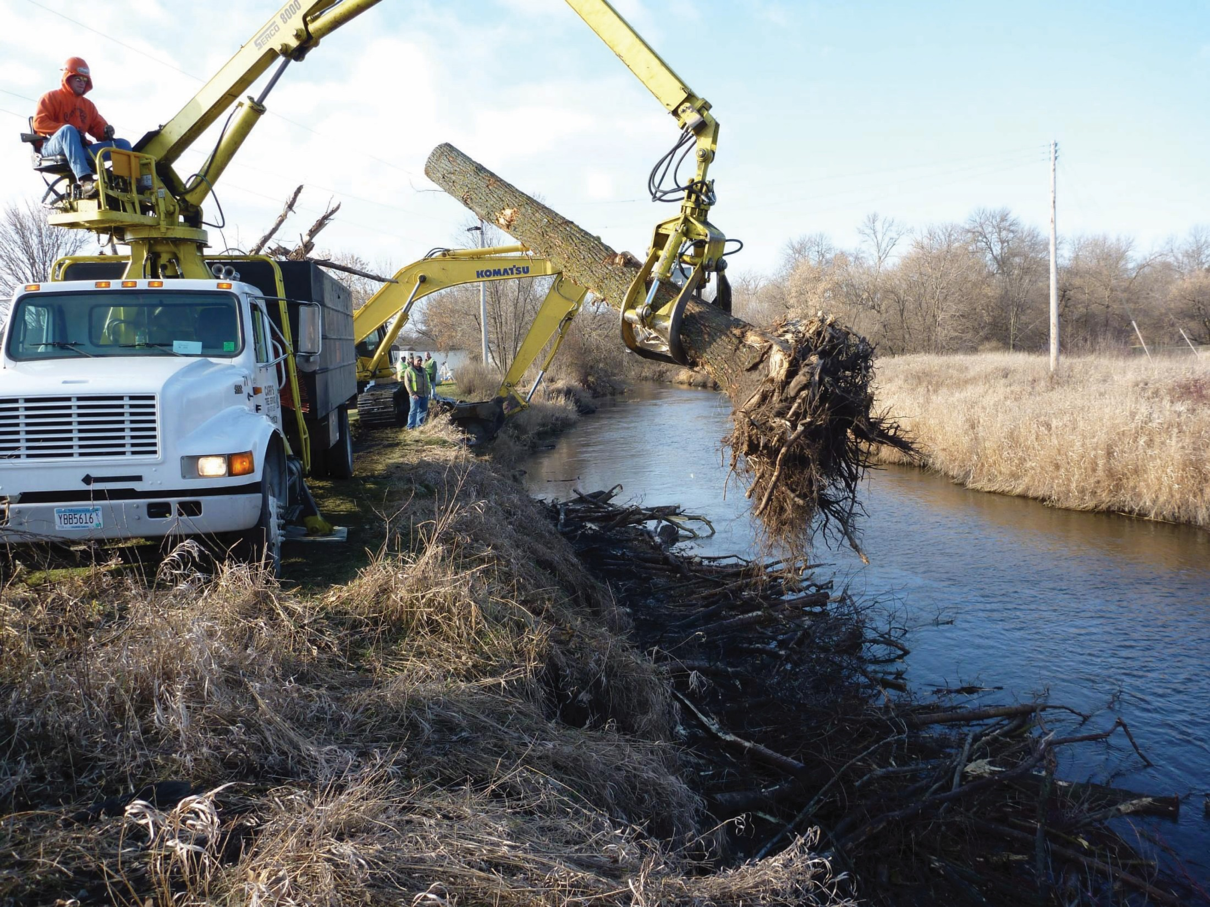
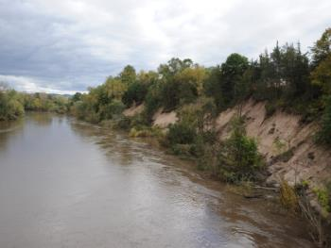
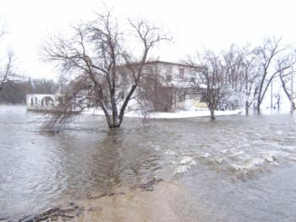
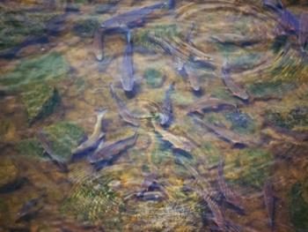
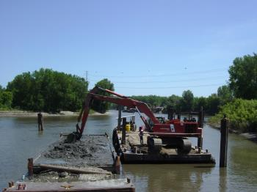
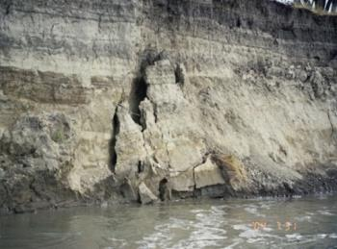
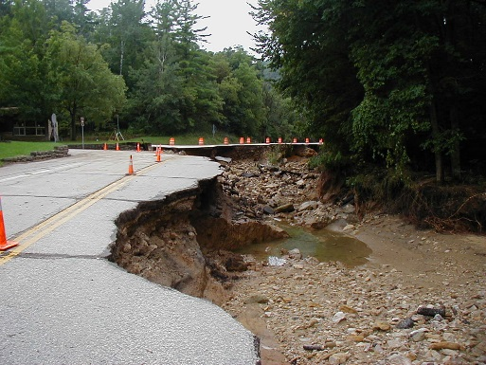
Sediment and Erosion impacts in Minnesota
Water Quality
Debris
Infrastructure
Habitat
Navigation
Notes:
Excess sediment in rivers indicates soil loss, exacerbates costs of dredging, degrades water quality, increases flooding, fills in Lake Pepin

Slide 16
Sediment work objective
Develop regional sediment loading information in the absence of available on-site local data for channel restoration projects
Drainage area,
Stability/stream characteristics,
Geology

Slide 17
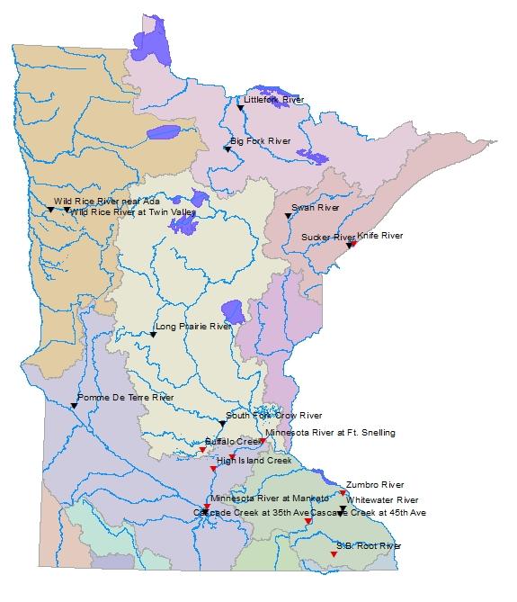
Good/Fair Stability
Poor Stability

Slide 18
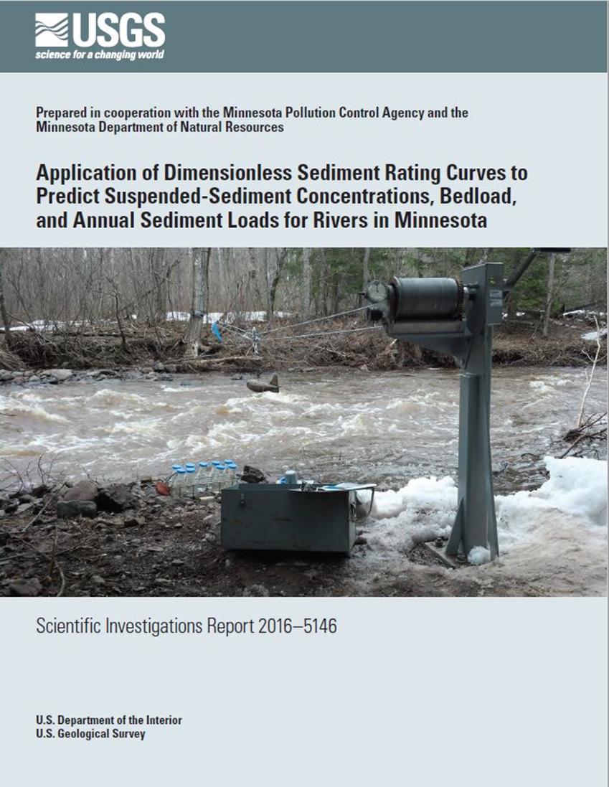

Slide 19
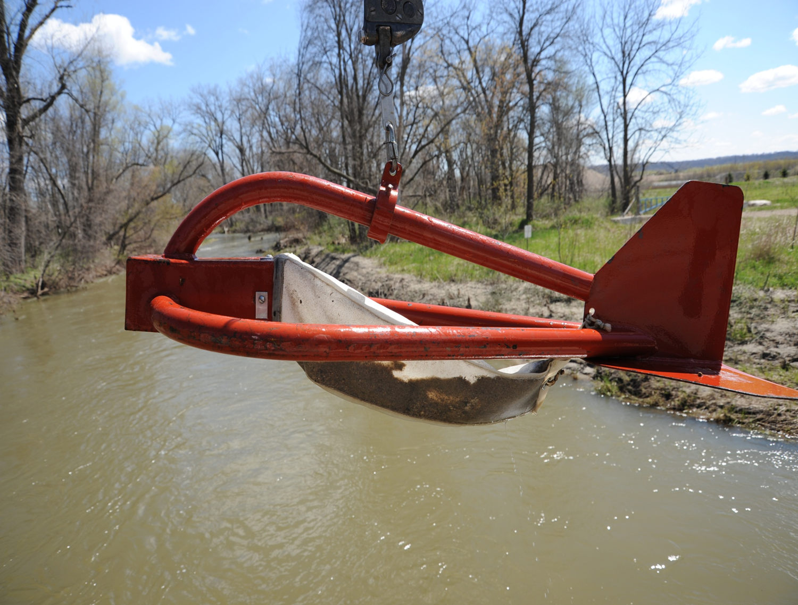
Summary
No analytical models accurately predict in-channel suspended and bedload concentrations
Understanding Sediment concentrations is essential to understanding river processes and stability
Collection of sediment and associated modelling is filling in gap in the WRAPS process
Predicting Sediment annual loads will improve channel restoration design

Slide 20
Additional importance of hydrologic information
Defining changes in local, regional and statewide hydrology
Change in the rainfall / runoff relationship through time
Define the climatic conditions and land use activities within the hydrologic records
Frequency and intensity of extreme hydrologic events – Floods, Droughts
Influence on Minnesota’s water use and infrastructure

